Slide 1

Intro to Version Control
16 Jan 2017
Dr. Greg Erhardt
261 OHR 859-699-1761 greg.erhardt@uky.edu

Slide 2
Let’s get today’s lesson…

Slide 3
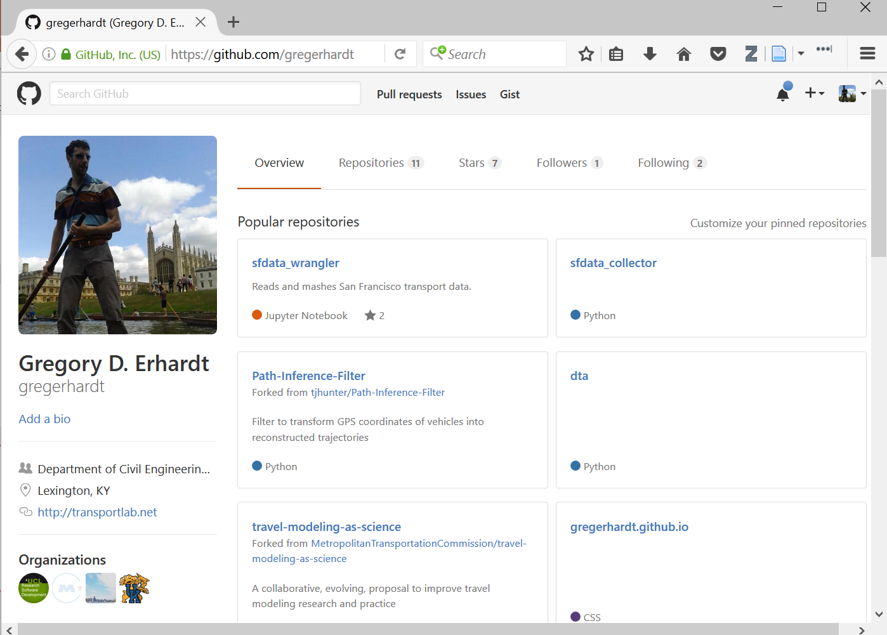
1. Go to github.com and log in.
2. Go to your account.
3. Accept my invitation.
4. Click on our organization.

Slide 4
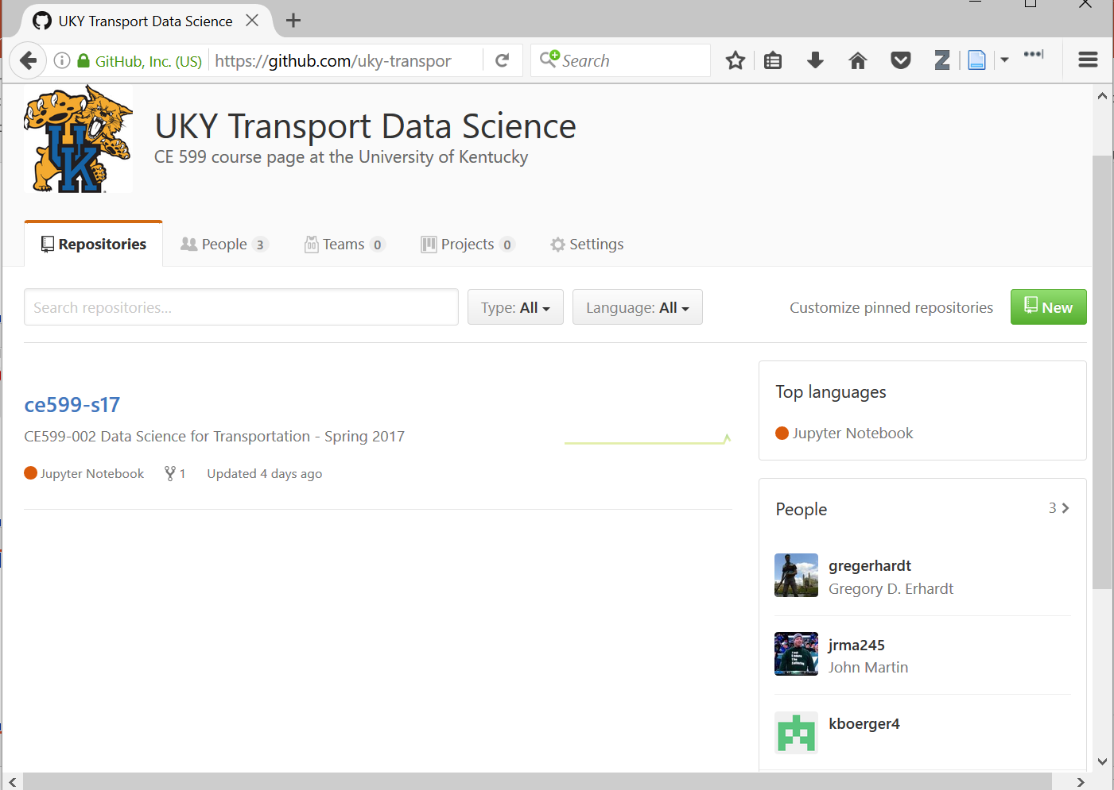
Let’s look at our class repository.

Slide 5
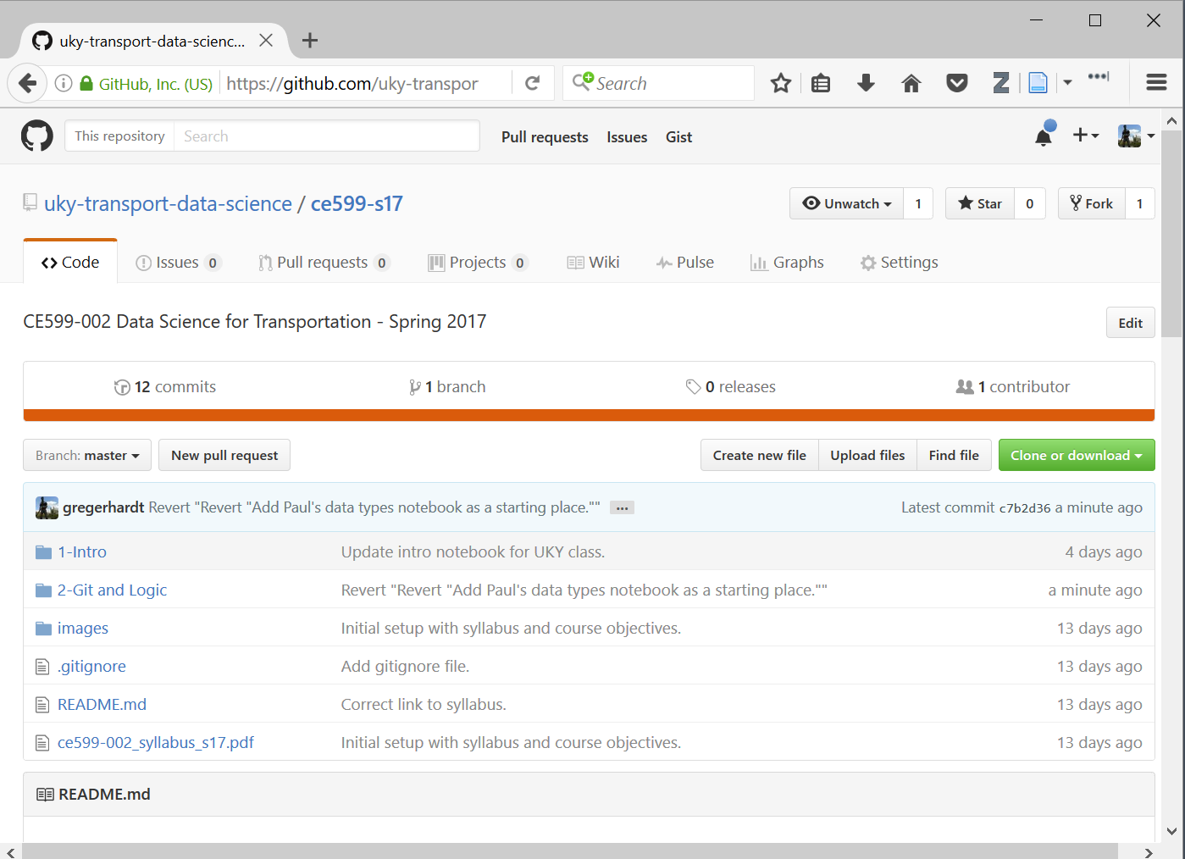
Remember, a repository is just a bunch of files.
Notice that lesson 2 is not posted.
Last time, we just downloaded them to our desktop. We’re going to do it differently this time.

Slide 6
The idea:
I am going to keep posting updates here.
I want you do get those updates.
I also want you to be able to make changes on your own, try new things, experiment, and save your work.
But I don’t want you messing up my nice MASTER version!!!
Version control lets us do that.
Git is version control software.
Github is a HOST that uses git.

Slide 7
Do this by creating a fork.

Slide 8
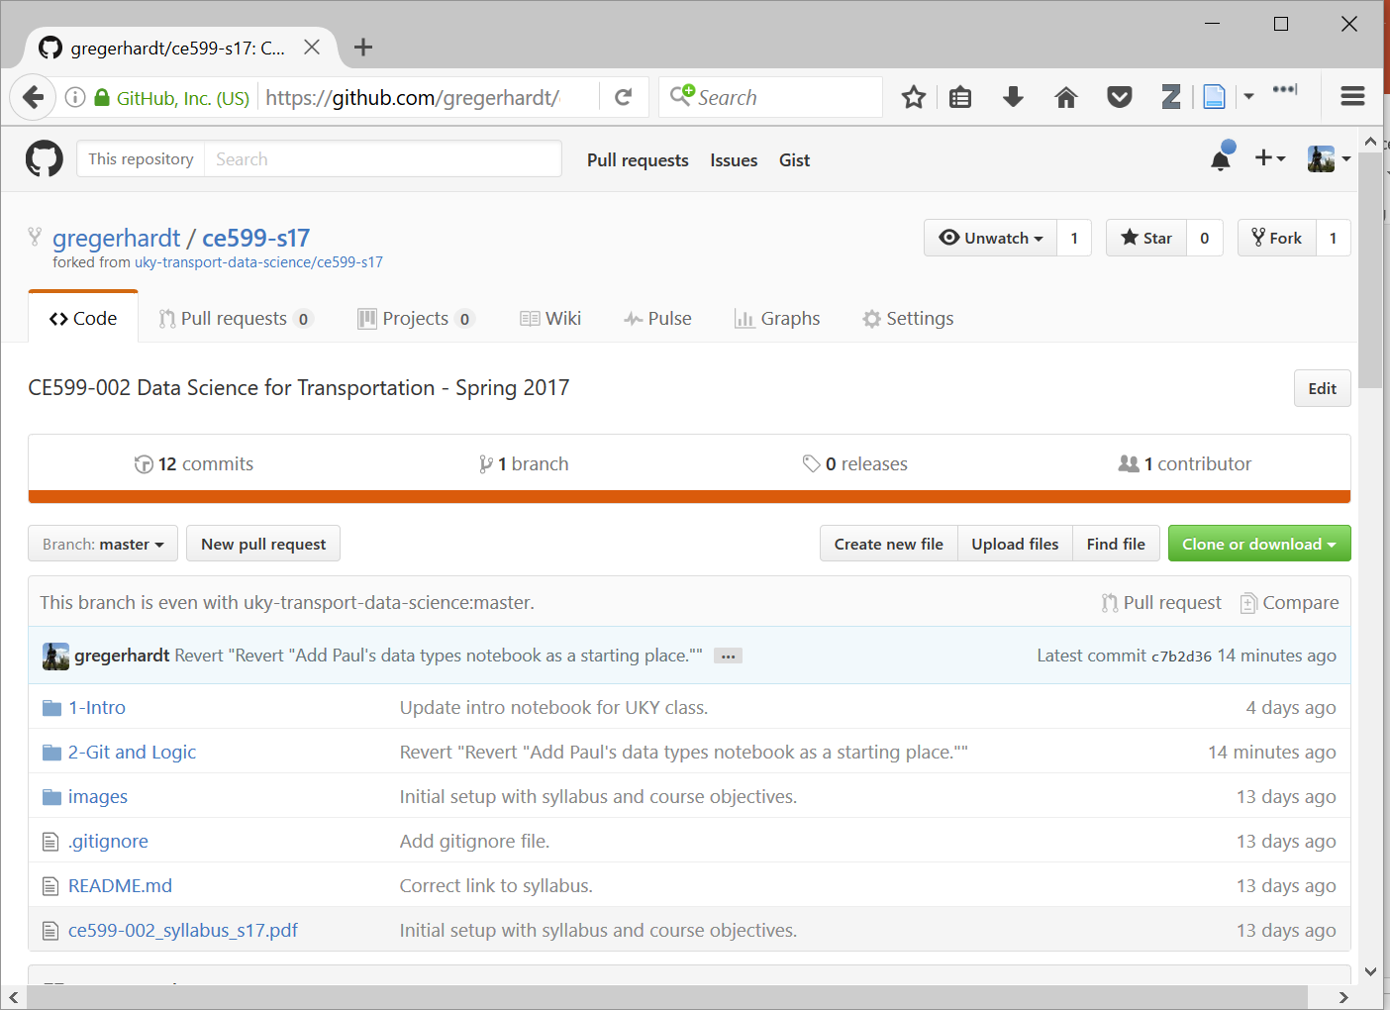
Now you have your own version under your account instead of our class organization.

Slide 9
The idea:
Now you have your own version that you are welcome to mess up!
But it is just sitting on a REMOTE website. You actually wan to work with it on your LOCAL machine.
We will use git to SYNC between the remote and the local version.
(Actually, we will use Github Desktop which puts a nice shiny GUI around git so we don’t have to remember all the command line arguments.)

Slide 10
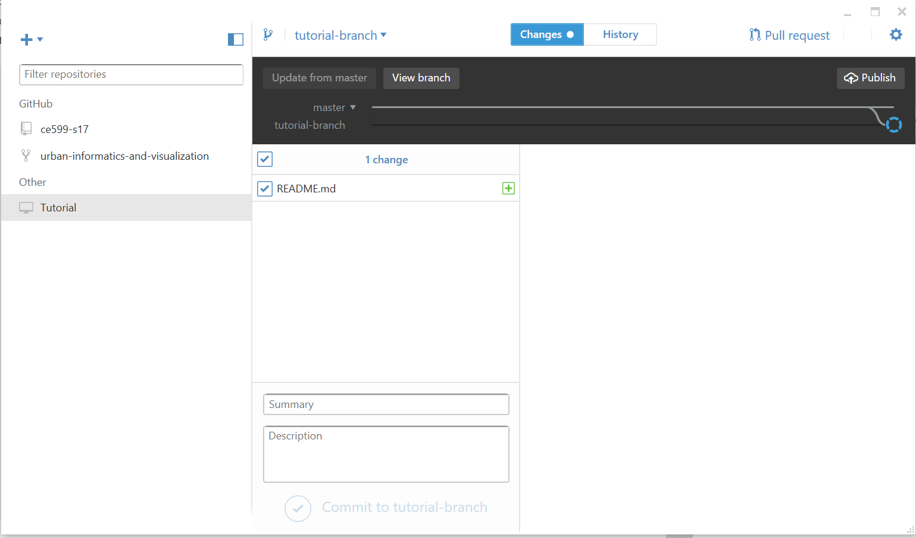
1. Open Github Desktop.
2. Clone your repository.

Slide 11
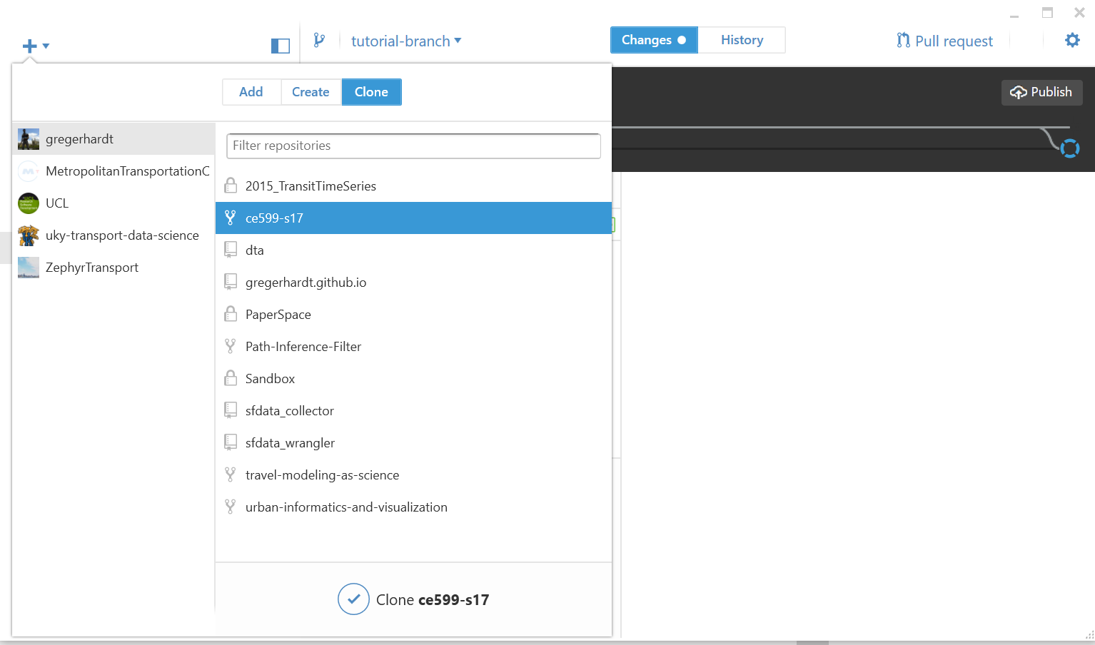
Clone your repository

Slide 12
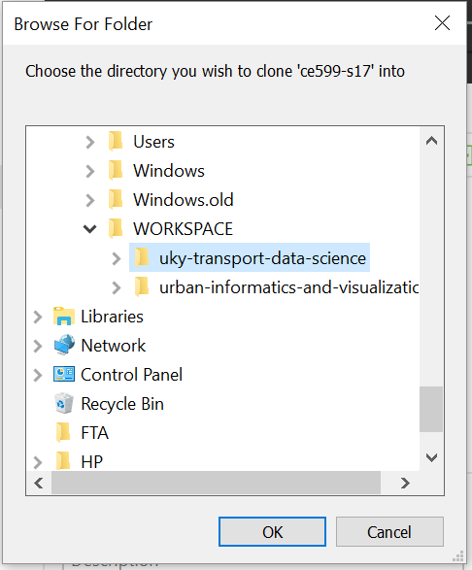
Store it somewhere logical.
I like to keep my repositories in C:\WORKSPACE\

Slide 13
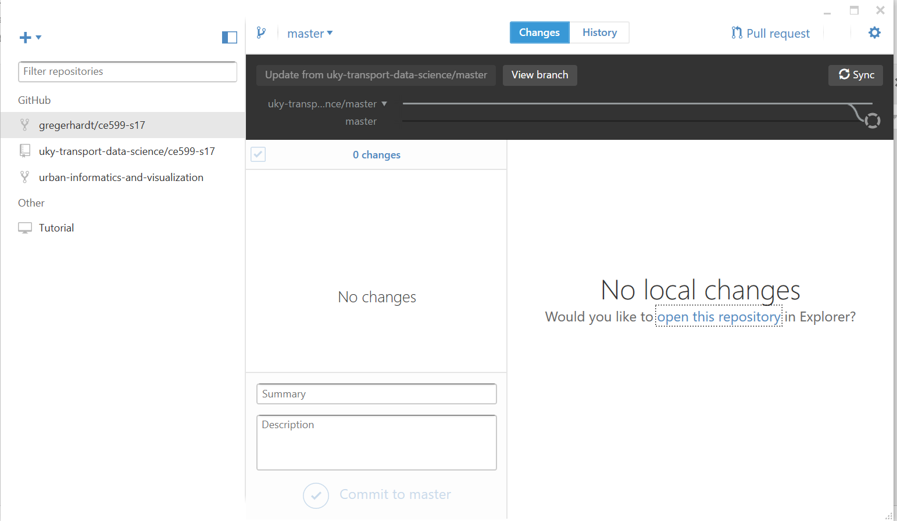
A few things to notice…

Slide 14
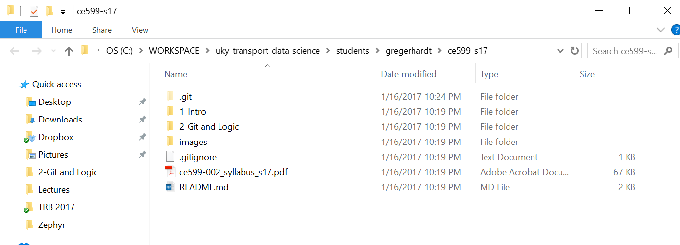
A few things to notice…
Now try changing something. Just add a text file and write a nice poem.

Slide 15
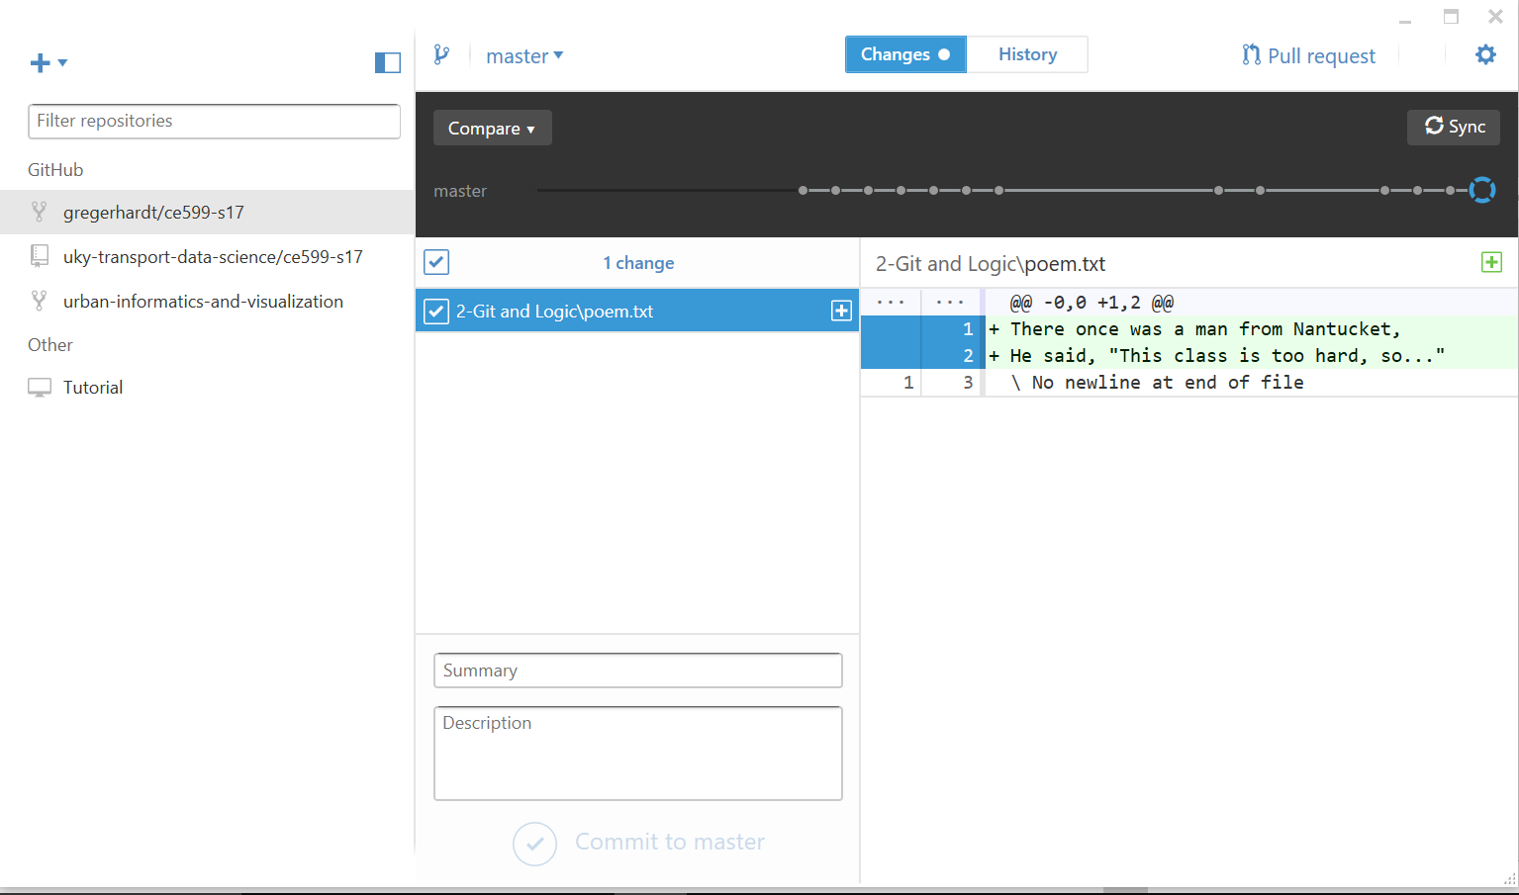
Go back to Github Desktop
Now, COMMIT the change to the repository.
Let’s look at the history.

Slide 16
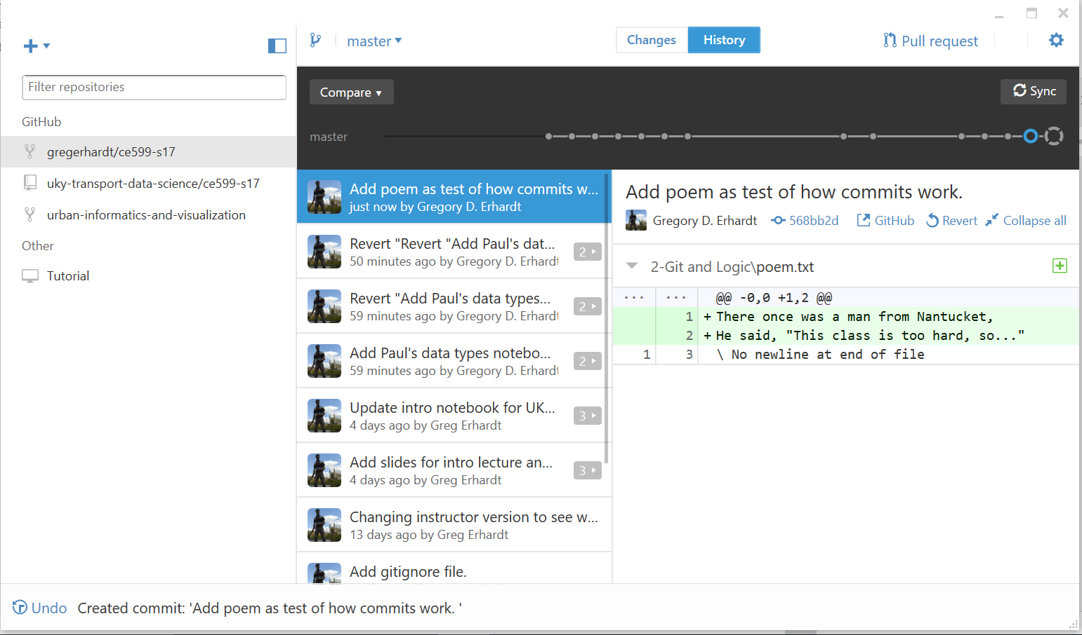
History stores a snapshot of every commit.
This means there is an “UNDO” button!
Now, let’s SYNC with the REMOTE repository.

Slide 17
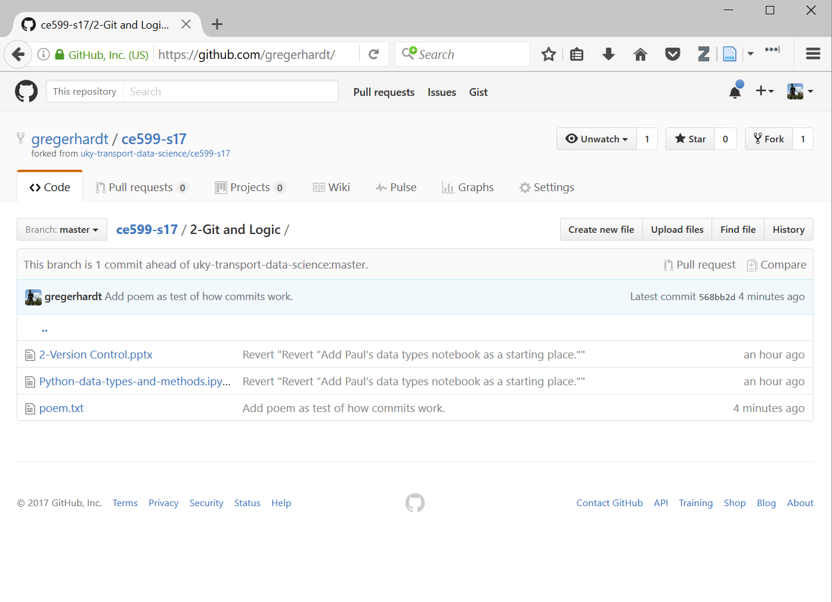
Notice that our current version is saved here.

Slide 18
The idea:
This is how you will submit your work in this class.
Next time, we’ll see what happens when I make changes to the MASTER version.
Version control makes collaboration and sharing practical in programming.
This is a big deal, because you don’t want to do everything yourself, from scratch!

